Slide 1
Lecture 13 Shortest Paths
Exercises
Department of Computer Science
Hofstra University
Acknowledgement: Lecture slides based on UofW Course on Data Structures

Slide 2
Q. Dijkstra’s Algorithm
Exam question: Given this directed graph, run Dijkstra’s Algo to find shortest paths starting from source node A. Give the node visit order, and fill in this table of SN (Shortest Distance) and PN (Previous Node), crossing out old SD and PN as you find a shortcut path with smaller SD
Visit Order
Node | SD | PN
A
B
C
D
E
F
G
start
2
B
A
1
1
5
2
E
1
1
D
C
5
3
2
6
G
10
F

Slide 3
Q. Dijkstra’s Algorithm (Source Node S)
ANS
ANS
A
A
2
Node | SD | PN
S | 0 | /
A
B
2
Node | SD | PN
S | 0 | /
A
B
S
S
1
3
4
4
B
B
ANS
ANS
A
A
Node | SD | PN
S | 0 | /
A
B
2
Node | SD | PN
S | 0 | /
A
B
2
S
S
1
1
4
4
B
B
3
Notes:
SD: Shortest Distance. PN: Previous Node

Slide 4
Q. Dijkstra’s Algorithm (Source Node A, Undirected Graph)
3
B
D
3
1
A
1
2
Node | SD | PN
A
B
C
D
E
1
C
E
4
Visit Order
4
Notes:
David Kauchak
cs161
Summer 2009
Graphs: MSTs and Shortest Paths https://cs.pomona.edu/~dkauchak/classes/algorithms/

Slide 5
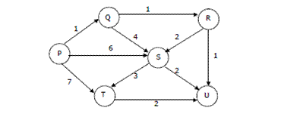
Q. Dijkstra’s Algorithm (Source Node P, Directed Graph)

Slide 6
Q. Topological Sort
Consider this DAG, use Topological Sort to find Shortest Paths in DAG, considering all possible topological orders
Visit Order
0, 1, 4, 7, 5, 2, 3, 6
B
Node | SD | PN
A | 0 | /
B
C
D
E
10
-20
A
D
1
E
1
1
C

